Slide 1

DebitCard
Team: Investment Insiders

Slide 2
Overview
Soap :
List all cards: Displaying all the cards.
Rest:
Its divided into 3 parts
Activate
Update
Blcok

Slide 3
Requirement Analysis
User Authentication and Authorization
Financial Tools and Resources
Mobile Banking Support
Technologies used:
Frontend Technologies
Backend Technologies
•Security Frameworks
•DevOps Tools
•Testing Frameworks

Slide 4
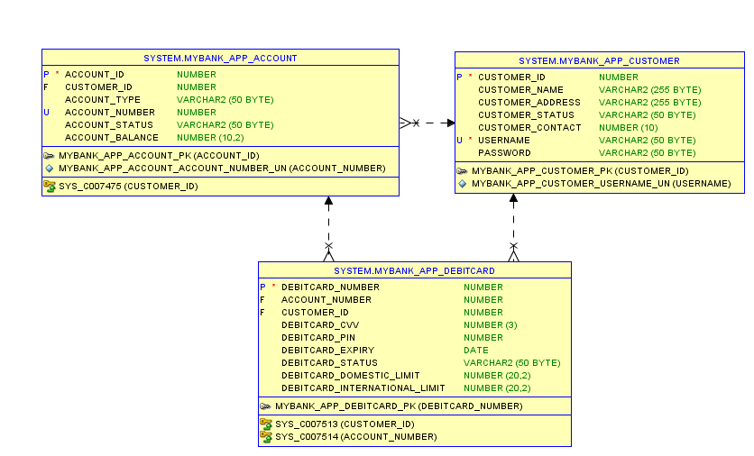
Database

Slide 5
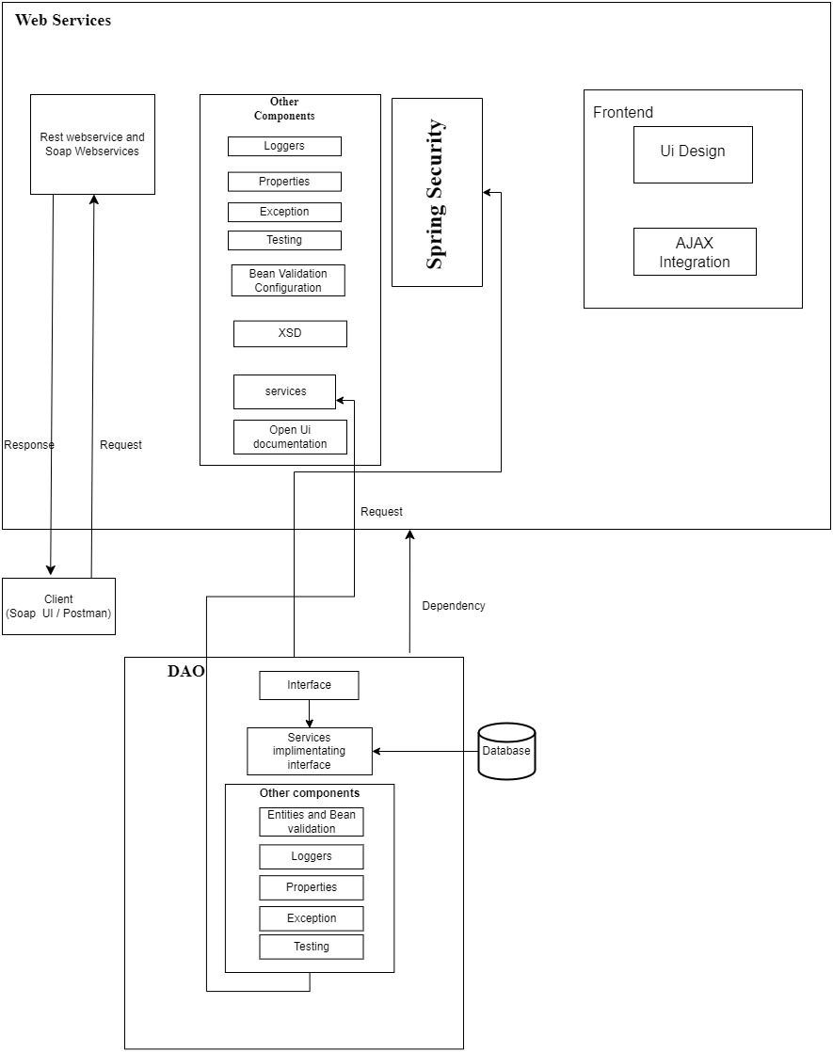
Architecture Diagram

Slide 6
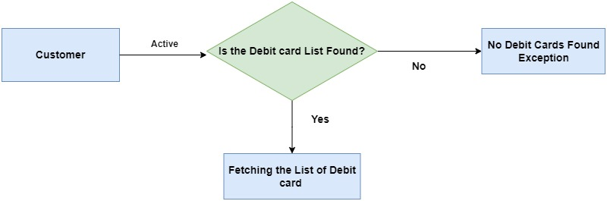
How List all works?

Slide 7
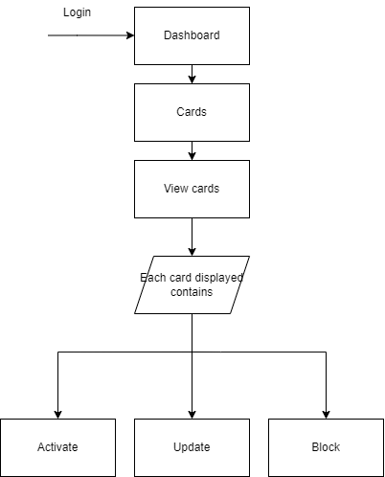

Slide 8
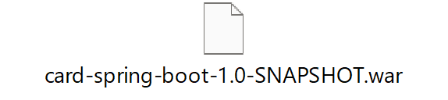
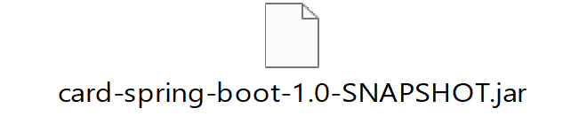
Jar File

Slide 9
GitHub Link
DLTE-JavaFullStack-Ankitha-2024/MyBank Project at master · Ankitha30/DLTE-JavaFullStack-Ankitha-2024 (github.com)

Slide 10
THANK YOU

